Slide 1


2018COMPANY INFORMATION
企业工作总结模板
LOGO

Slide 2


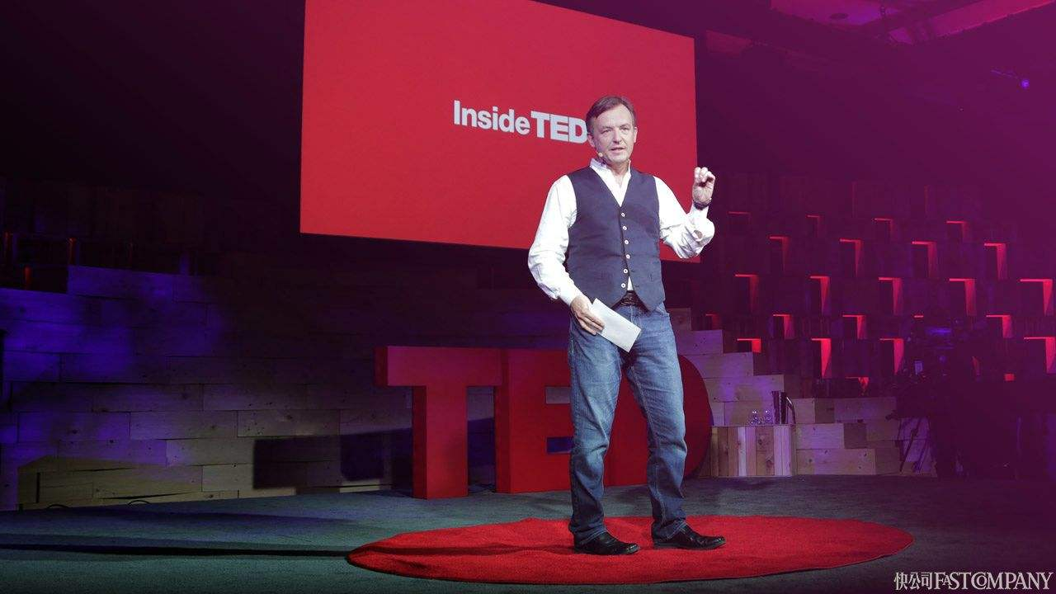

More closer to work and more important
presentation
interview
University
Speech
Organizing

Slide 3
Solidify personal brand
Words
Actions
Easier and quickly to build up personal brand
Depend on ourselves
Without limits
Much slower to build up personal brand
Rely on others’ attention
Have limits

Slide 4
To summarize
Words speak louder than actions
1
2
3
Words are the prerequisite of actions
Words can make actions more efficient while actions will be messed up without words
Words help people solidify brands, strength your influences, seize opportunities quickly while actions are much slower

Slide 5
Thank You!

